Slide 1
SELF-ORDERING APP

Slide 2
INTRODUCTION
In our mini project, we are going to develop an iOS based, self ordering app for restaurants. Each table in the restaurant will be fixed with a tab/phone with this app installed in it. When the app is opened, it leads the customers to the main page which has different categories of cuisines like starters, deserts, beverages etc.. Once the customer selects the category, he will be redirected to a different page which contains the menu of that particular category. Each food item along with its price will be displayed on this page.
Normally in restaurants it takes a lot of time for the staff to come and take the order . This app helps in eliminating the wastage of time as the customers can place the order themselves without any waiting time, so that you can get your order more faster . It even avoids the common mistakes made by the stewards while taking down the order . All such problems can be solved while using this app.

Slide 3
LITERATURE SURVEY
FINEDINE
IN-SEAT FOOD ORDERING
The Mobile Menu allows you to share your menu with any mobile device without having to download an application. Simply scan the QR code with the camera application on your iOS device or the QR scanner on your Android device to view the menu.
QR code allows guests to check your menu when they’re at the restaurant. They can place their orders from their table without any help from the staff.
The online in-seat delivery ordering system allows customers to have their order delivered to their seat without having to stand in a queue and miss the show. This is available no matter the venue: theaters, convention centers, stadiums, or in restaurant seats.
Once a customer places an order, you will get a notification either through the OrderEm app, phone call, text, or email with: the order details & item details, fan seat number, and notes. Your kitchen will then prepare the food and notify your runners to deliver the order directly to the customer seat.

Slide 4
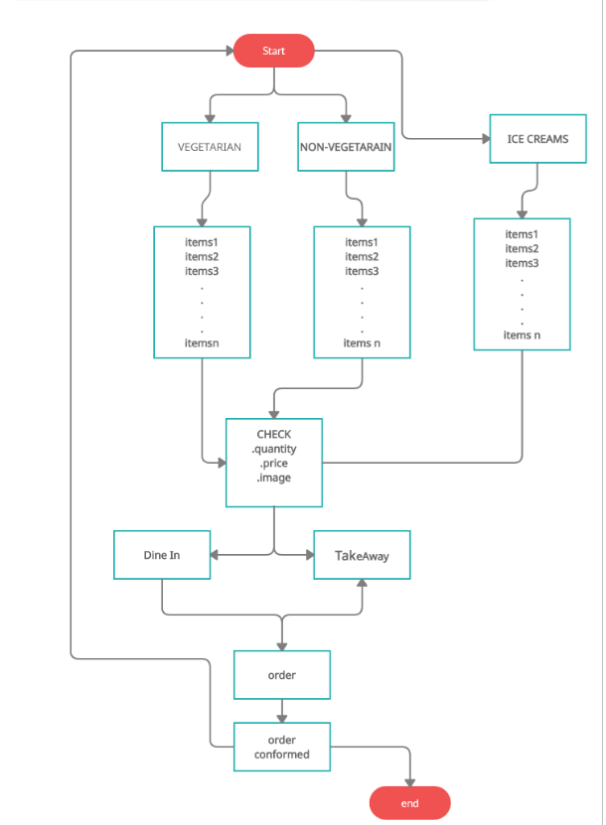
Flow chart

Slide 5
FUTURE SCOPES
It benefits the owners as they need not to hire more employees for the work, which increases the profit in the business.
It reduces the time for ordering the food items.
Social media integration has become a permanent feature for every app out there. For the restaurant industry even more, what with the customer’s need to review their experience.
It would be more comfortable while ordering food items in an app.
For example, this app would be more useful in these kind of pandemic situation.

Slide 6
SOFTWARES AND TOOLS USED
Xcode:
It is used to develop an application using Swift language

Slide 8
REFERENCES

Slide 9
Thank You

